Slide 1


Professional Readiness for Innovation, Employability and Entrepreneurship
GOVERNMENT SCHEMES RECOMMENDATION CHATBOT
210701057– Divya sri S J
210701060 – Gayathri Priya J
Dr.T.Kumaragurubaran
Computer Science and Engineering Department - REC

Slide 2
PROBLEM STATEMENT
How can we create a chatbot that can provide reliable and relevant information about various government schemes to the citizens,and help them identify their eligibility criteria for different programs

Slide 3
Abstract
The "Government Scheme Recommendation Chatbot" is an innovative project aimed at enhancing the accessibility and awareness of various government schemes available to citizens in India. The chatbot is designed to cater to diverse user groups, including farmers, students, women, differently-abled individuals, and more, offering detailed information about relevant schemes, eligibility criteria, and benefits. However, the dissemination of information about these schemes and their specific details remains a challenge. Many citizens, especially those in rural and underserved areas, are unaware of the schemes they qualify for. This project addresses this gap by providing an interactive platform where users can easily access information about various government schemes tailored to their needs.

Slide 4
Existing System
In the current landscape, several systems and methods are utilized to disseminate information about government schemes to the public. These methods include traditional media (such as newspapers, television, and radio), official government websites, public service announcements, community outreach programs, and physical information centers. Each of these approaches has its own set of advantages and limitations.Traditional media remains a prominent source of information dissemination. Newspapers, television, and radio are commonly used to announce new schemes, provide updates, and educate the public about various government initiatives. While these channels can reach a broad audience, they often fail to provide detailed, personalized information. Additionally, traditional media may not be as effective in rural and remote areas where access to such resources is limited.

Slide 5
Proposed System
The proposed "Government Scheme Recommendation Chatbot" aims to address the limitations of the existing systems by leveraging advanced technologies to provide an interactive, accessible, and personalized information dissemination platform. The system will include a user-friendly graphical user interface (GUI) to facilitate seamless interaction. The system will feature a GUI developed using the Tkinter library in Python. The interface will be designed to be intuitive and easy to navigate, ensuring that users can interact with the chatbot effortlessly. The chatbot provides instant responses to user queries, significantly reducing the time and effort required to find relevant information compared to traditional methods.

Slide 6
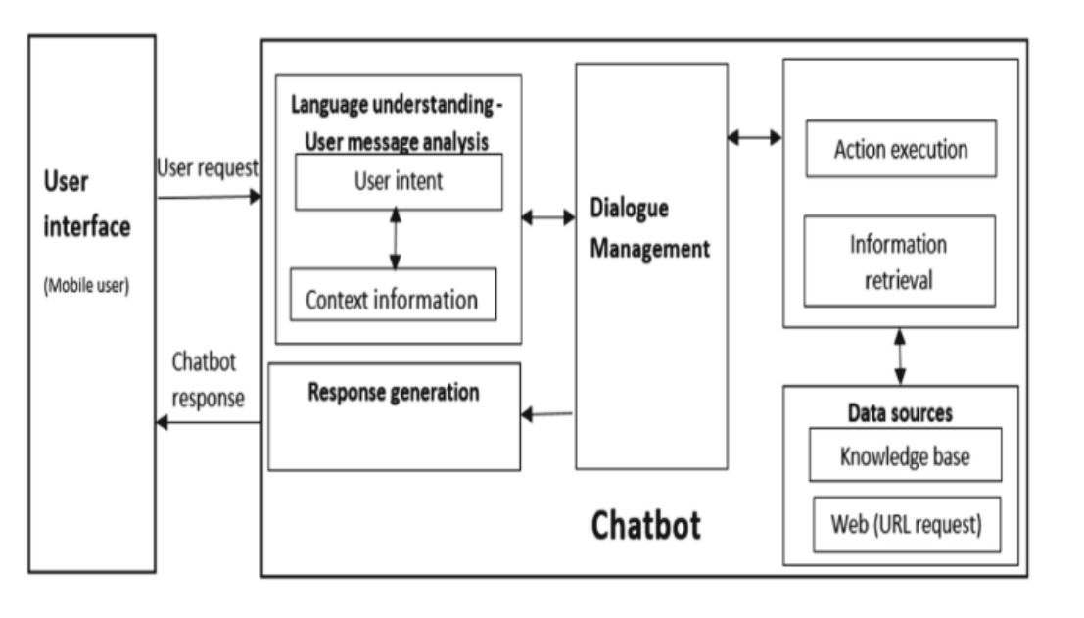
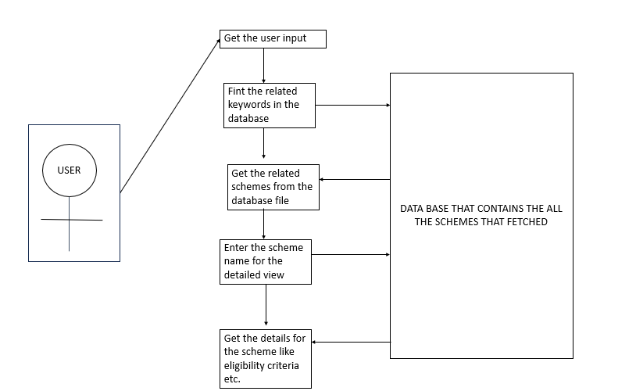
Architecture Diagram

Slide 7
Project Modules
Training Module :
The training module is responsible for preparing the dataset and enhancing the chatbot's ability to understand and respond to user queries effectively. It includes data preprocessing, vectorization, and the implementation of text-matching algorithms.The model learns by comparing its answers to correct ones and adjusting until it improves. It is then tested with new data to ensure accuracy. This component involves loading the dataset containing information about various government schemes. The dataset includes columns such as 'Scheme Name', 'Description', 'Eligibility Criteria', and 'Benefits

Slide 8
Project Modules
Chat Module :
The chat module provides an interactive interface for users to query and receive recommendations on government schemes. It handles user interactions, processes queries, and displays results.Built using the Tkinter library, the GUI includes text entry fields for user queries, buttons for submitting queries, and an area for displaying results.This function captures user input, processes it, and displays a list of matching scheme names.This function takes the scheme name provided by the user and displays the detailed information about the selected scheme..

Slide 9
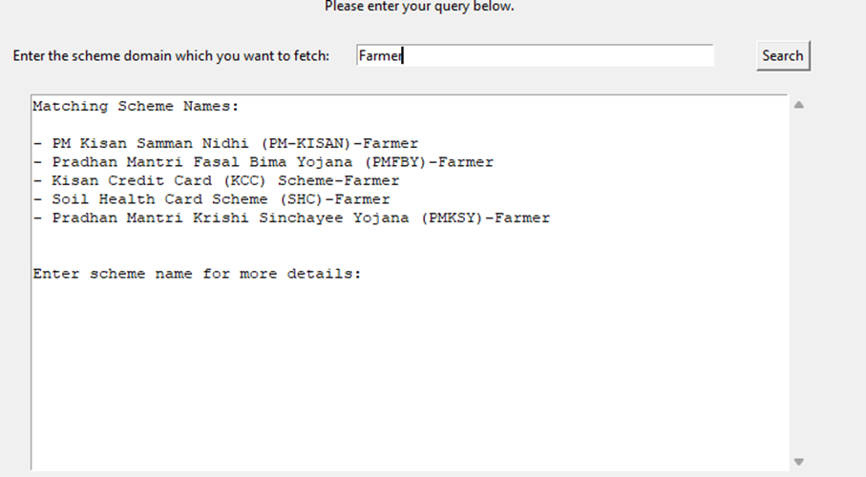
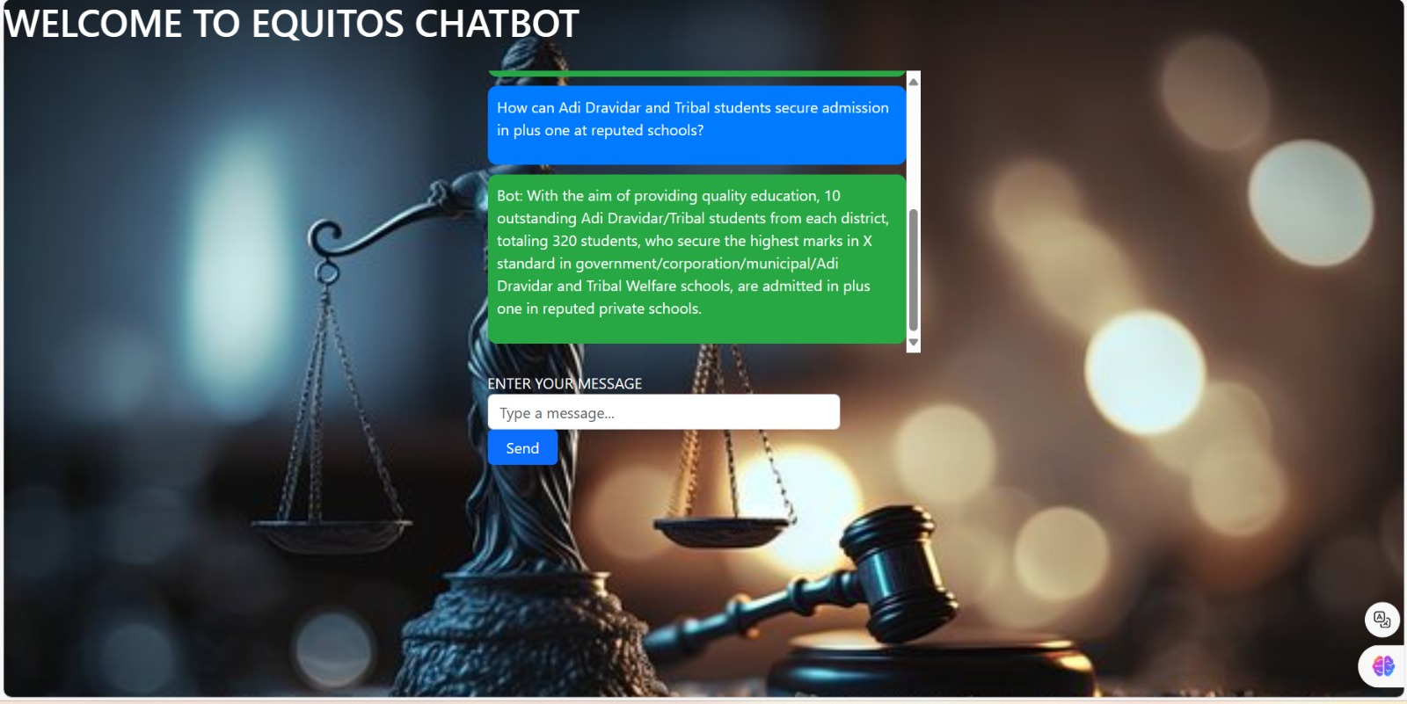
Output

Slide 10
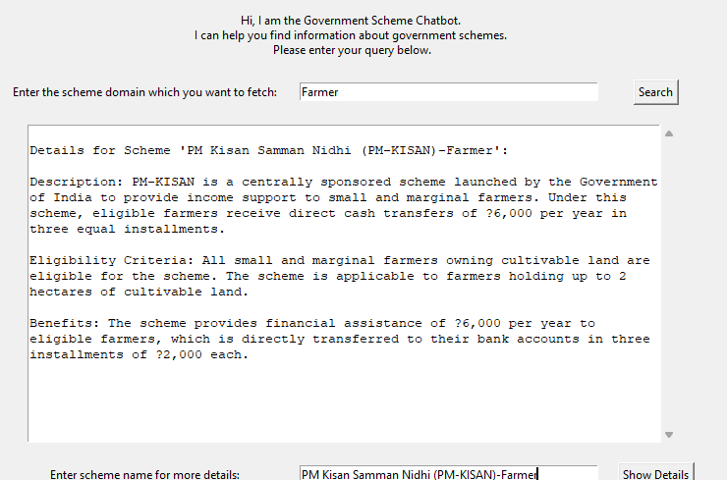
OUTPUT

Slide 11
Future Enhancements
Our chatbot can further be enhanced by adding some of the features like
Integration with government portals
Multi Language support.
Integrating with chatgpt.
Feedback mechanisms

Slide 12
Thank You

